Slide 1

Design and Simulation of a 4-bit Binary Arithmetic Calculator
Batch Number:1
Thummeti Teja-2620030003
Prakash Machgaiya-2620030067
ANANYA MALKAPURAM-2620030060
Sai Lakshmi Harshini Pemmaraju-2620030063

Slide 2



Project Introduction
Domain Background
Significance & Relevance
Binary arithmetic units form the fundamental computational backbone of modern microprocessors, digital signal processors (DSPs), and embedded microcontrollers.
Low-Latency Hardware Execution: Dedicated logic gates enable single-clock cycle addition, subtraction, and bitwise logic operations.
At the lowest hardware level, all mathematical computations are executed using combinations of combinational logic elements that process binary signals (0 and 1).
Educational & Industrial Value: Demonstrates the conversion from Boolean algebraic equations to optimized schematics and Hardware Description Language (HDL).
Understanding a 4-bit arithmetic system provides crucial insights into central processing unit (CPU) ALU architecture and bus communication.
Simulation Verification: Pre-fabrication verification eliminates design errors before physical ASIC or FPGA synthesis.

Slide 3






Problem Statement
Hardware Complexity
Propagation Latency
Inflexible Routing
Traditional discrete implementations use separate dedicated ICs for each arithmetic and logic operation, leading to high chip count, severe board area wastage, and complex trace routing.
Unoptimized cascaded full adders introduce cumulative ripple-carry propagation delays, limiting operational frequency and overall system throughput in multi-bit calculations.
Without integrated multiplexing and control logic, switching between arithmetic (ADD/SUB) and logic operations (AND/OR/XOR) requires manual hardware re-wiring.
Core Objective: To overcome these drawbacks, this project designs an integrated, multi-mode 4-bit binary calculator that unifies arithmetic and logic functions using multiplexed logic blocks verified via software simulation.

Slide 4
Key Objectives
4-Bit Combinational Core Development
Design a 4-bit arithmetic circuit capable of executing Binary Addition and 2's Complement Subtraction for inputs up to 15 (1111₂).
Bitwise Logic Integration
Incorporate a bitwise logic engine performing AND, OR, and XOR functions across two 4-bit operand vectors (A[3:0] and B[3:0]).
Multiplexed Control & Status Detection
Implement a 4x1 Multiplexer control stage to dynamically select target outputs while tracking Carry-Out Cout .
Simulation & Timing Verification
Simulate circuit schematics and Verilog RTL modules using Xilinx Design Suite / Proteus to validate truth table responses and measure signal delay.

Slide 5

Proposed Calculator System
Architectural Highlights
Key Features & Capabilities
Integrated Functionality: Combines a 4-bit Parallel Adder-Subtractor with a 4-bit Bitwise Logic Array connected to a 4x1 MUX.
5 Operational Modes: Addition, Subtraction, Bitwise AND, Bitwise OR, and Bitwise XOR.
Flag Signals: Real-time detection of Carry-Out (Cout).
2's Complement Subtraction: Uses XOR gates on Input B controlled by mode selector $M$. When $M=1$, Input B is inverted and Cin=1, executing
A + bar{B} + 1.
Arithmetic Subtraction Formula:
Unified Bus Output: All computational sub-modules feed into a 4-bit wide multiplexer array, yielding a single unified 4-bit result output.

Slide 6
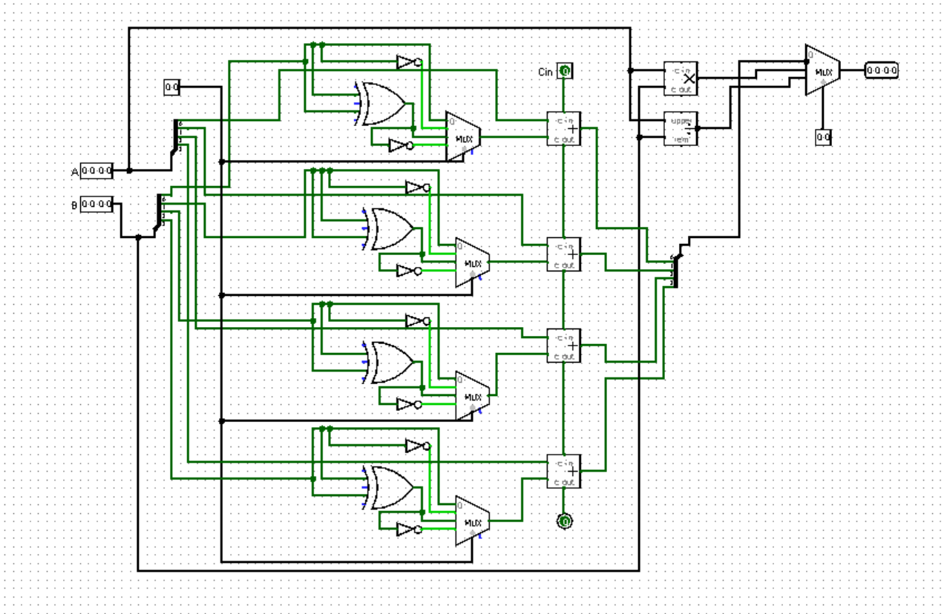




Block Diagram & Signal Flow
1. Input Operand Stage
DIP Switches feed two 4-bit binary numbers A[3:0] and B[3:0] into internal data buses.
2. Controlled Inverter Array
Mode pin M controls XOR array to pass B unchanged (M=0) or invert B for 2's complement (M=1).
3. 4-Bit Ripple Carry Adder Core
Cascaded full adders process sum outputs S_0..S_3 and pass carry bits C_0 \rightarrow C_3$.
4. MUX Selector & Display Stage
Selectors S_1, S_0 route selected result to output LEDs and BCD 7-segment driver.

Slide 7
Design Methodology & Logic
Full Adder Logic Design
Each bit position utilizes a Full Adder described by standard Boolean logic expressions:
|
Adder/Subtractor Mode Control
For Addition ($M=0$): $C_{in}=0$, Input B is untouched.
For Subtraction ($M=1$): $C_{in}=1$, Input B is bitwise inverted giving $A + B' + 1 = A - B$.
Multiplexer Routing Table
Control lines ($S_1, S_0$) select the operational unit output:
00 = Arithmetic (ADD/SUB) | 01 = Bitwise AND | 10 = Bitwise OR | 11 = Bitwise XOR.

Slide 8

Conclusion :
Project Achievements
Successfully designed and validated a multi-functional 4-bit binary arithmetic and logic calculator unit.
Integrated 2's complement signed/unsigned subtraction with automatic carry and overflow status flags.
Verified functional timing responses and switching waveforms via Xilinx ISE / Proteus simulation.
Achieved minimal chip footprint through effective multiplexer bus sharing.

Slide 9
Thank You

